Slide 1
Fundamentals of Security
CCTM 180

Slide 2
Outline
Security definition
Information Security definition
Three pillars of Information security
Physical
Operational
Management
Goals of Information Security

Slide 3
What is Security
Computer security is a very broad topic
To differing stakeholders within an organization the meanings are different.
Physical security of servers and workstations and protecting them from those who might try to steal them or from damage that might occur if the side of the building collapses?
Data security protecting it from viruses and worms or from hackers and who have suddenly targeted your system and/or organization.
File restoration security may mean restoration features if a user accidentally deletes them.
It may be impossible to define a succinct definition because the topic area is so broad

Slide 4
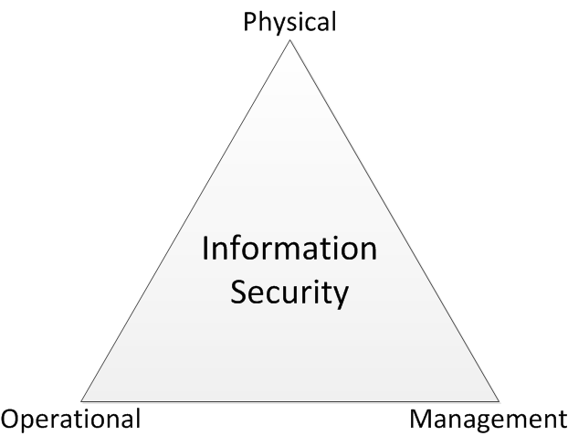
Three Pillars of Information Security
Information security covers wide array of activities in an organizations information
Prevention of unauthorized data
Access
Modification
Deletion

Slide 5
Physical Security
Physical security, is the protection of hardware, software and data assets from physical access by unauthorized persons.
Threats often present themselves as service technicians, janitors, customers, vendors, or even employees.
Their motivation may be retribution for some perceived misgiving, a desire to steal your trade secrets to sell to a competitor as an act of vengeance, or just greed.

Slide 6
Operation Security
Operational security focuses on the process of how a organization completes its information processes and the relationships to risk.
Encompasses everything that isn’t related to design or physical security in your network. Instead of focusing on the physical components where the data is stored, such as the server, the focus is now on the topology and connections.
http://www.tbs-sct.gc.ca/pol/doc-eng.aspx?id=12328

Slide 7
Management Security
Management and policies provide the guidance, rules, and procedures for implementing a security environment.
Policies, to be effective, must have the full and uncompromised support of the organization’s management team.
Management directions can give security initiatives the teeth they need to be effective. In the absence of support, even the best policies will be doomed to failure.

Slide 8
Goals of Information Security
Prevention refers to preventing computer or information violations from occurring; it is much easier to deal with violations before they occur than after.
Detection refers to identifying events when they occur.
Response refers to developing strategies and techniques to deal with an attack or loss.

